Slide 1
MERN Stack
RC Balaji
B.Tech -IT

Slide 2
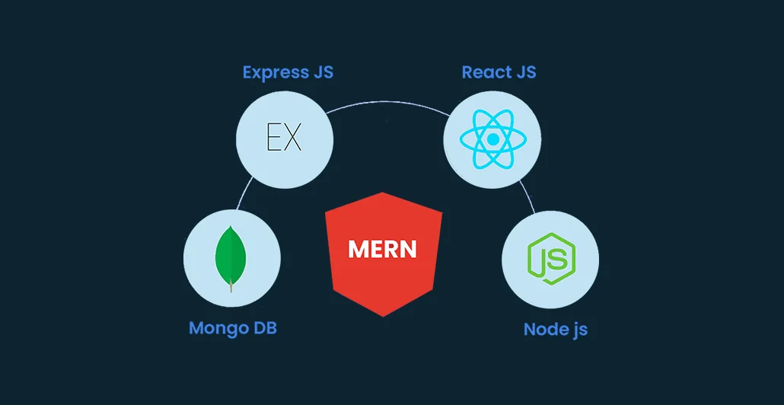
Overview
The MERN stack is an open-source full-stack JavaScript solution for rapidly developing and deploying full-stack applications. This, therefore, states that fact that MERN is the most effective platform for creating websites and applications. As a result, each component of MERN has a distinct purpose.

Slide 3
Overview of MongoDB, Express.js, React, and Node.js
MongoDB
Express.js
A powerful NoSQL database solution known for its scalability and flexibility.
A fast and minimalist web application framework for Node.js, simplifying server-side development.
React
Node.js
A runtime environment that allows JavaScript code to run on the server-side.
A popular JavaScript library for building dynamic user interfaces.

Slide 4
Why MERN stack?
Code Reusability
Community and Learning Resources
Scalability
Easy to Learn

Slide 5
CURD

Slide 6
CRUD

Slide 7
CRUD Operations:-
Create a element
Read a element
Update a element
Delete a element

Slide 8
For that:-
We have to develop a Simple Application

Slide 9
Any Guess?

Slide 10
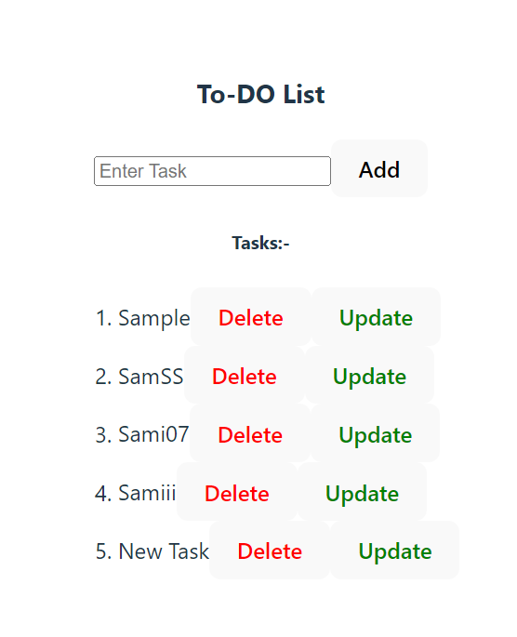
A To-Do List

Slide 11
Shall We START?

Slide 12
404 - Page Locked!!!
You are not Allowed to Next!!!

Slide 13
Why??

Slide 14
You are asked to unlock some pre-request to allow

Slide 15
What are the Pre-request
React :-
MongoDB:-
useState()
useEffect()
map()
try…catch
then…catch
Model Schema
Method use for add a element
Method use for read a element
Method use for update a element
Method use for delete a element

Slide 16
What are the Pre-request
Express :-
Routing
Http Methods
http://localhost:5000
http://localhost:5000/api/tasks
http://localhost:5000/api/:id
req and res object
Node :-
How to start a Server
How to run a JS file
Import and export
async and await

Slide 17
OMG!!! Really you Unlock this??

Slide 18
Oki,That’s fine
Let’s Start →

Slide 19
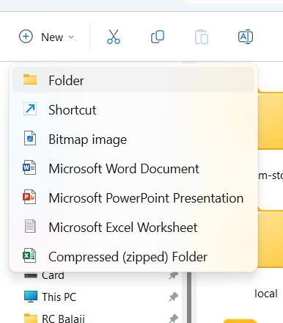
Create a New Folder

Slide 20
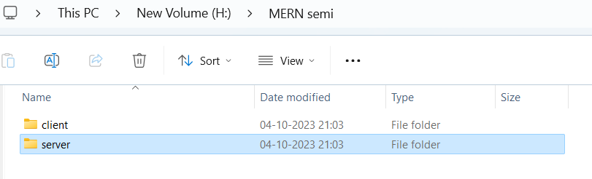
Create 2 folders

Slide 21
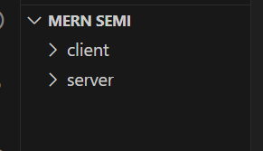
OPEN this Folder in VS code

Slide 22
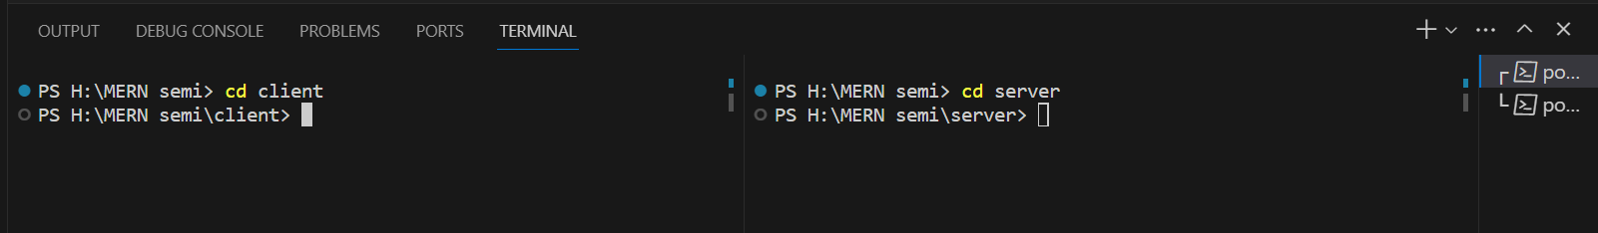
Open and Split the VS Terminal (ctrl + ` or ~ )

Slide 23
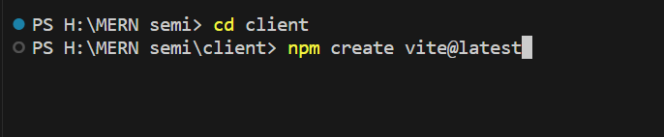
React
Create a React App inside Client folder

Slide 24
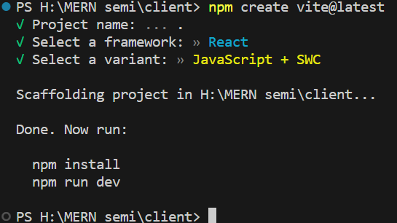
React
Create a React App inside Client folder

Slide 25
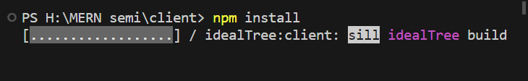
React
Create a React App inside Client folder
Install necessary packages

Slide 26
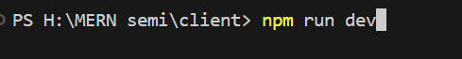
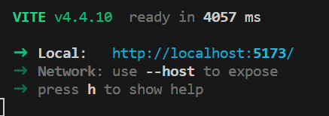
React
Start the app

Slide 27
Why npm run dev not npm start?

Slide 28
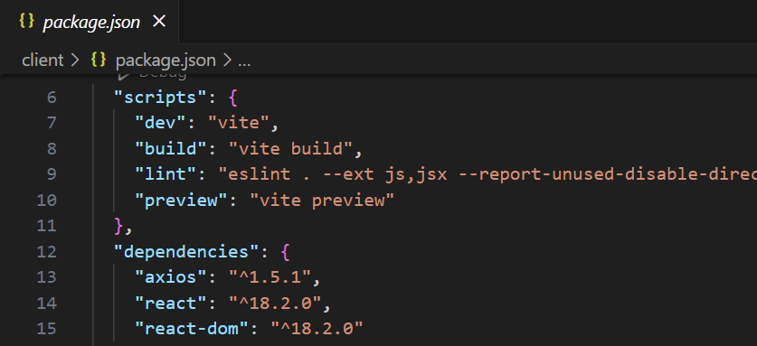
React
Bcoz,

Slide 29
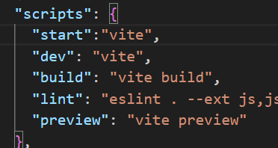
React

Slide 30
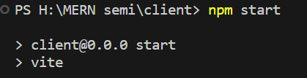
React Now , start the app using npm start

Slide 31
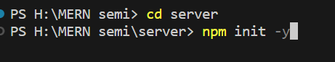
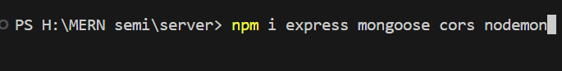
Node
Init the server dir
Install necessary packages

Slide 32
Wait, What will be the first?? Frontend or Backend

Slide 33
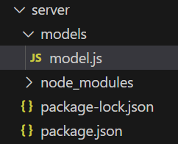
MongoDB
Create model schema for MongoDB

Slide 34
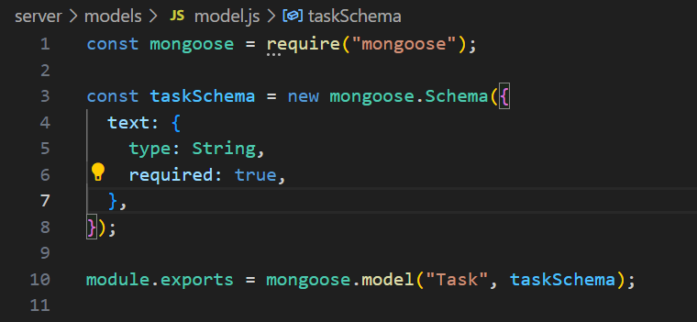
Node
Inside model.js

Slide 35
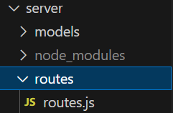
Express
Create routes for the express

Slide 36
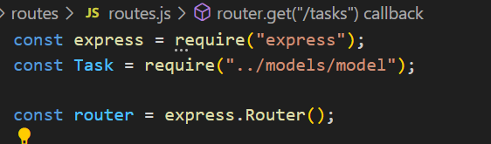
Express
Import necessary packages inside router.js

Slide 37
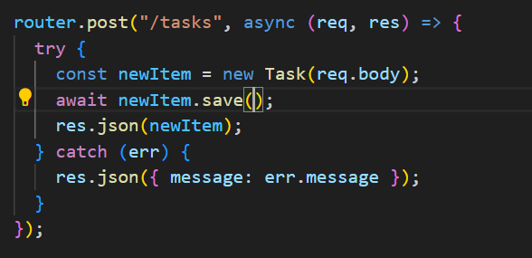
Express
Create an element

Slide 38
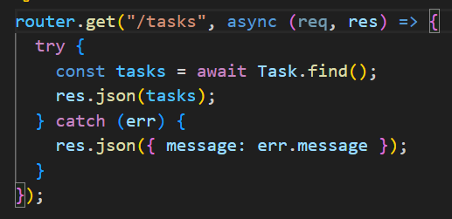
Express
Read an element

Slide 39
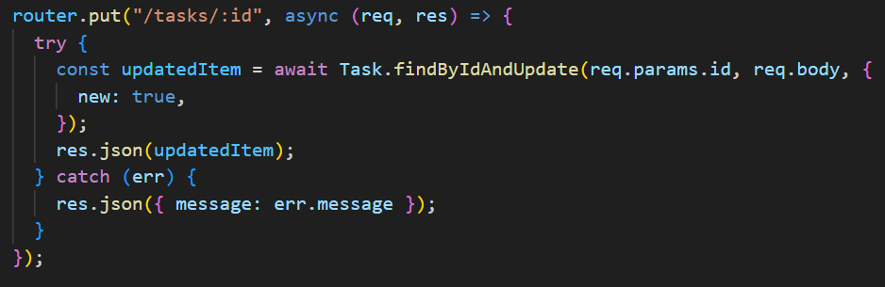
Express
Update an element

Slide 40
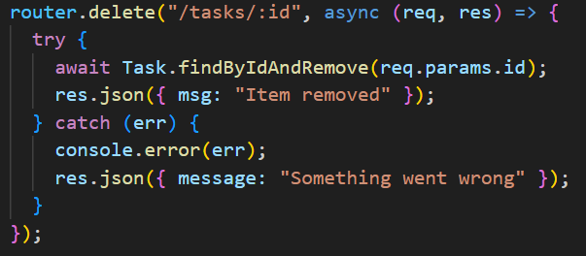
Express
Delete an element

Slide 41
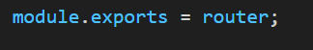
Express
Export the router

Slide 42
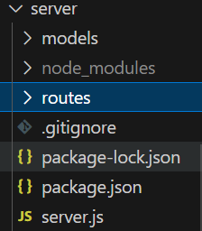
Node
Create server.js

Slide 43
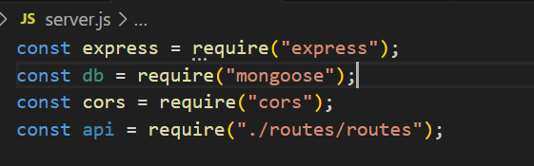
Node
Import necessary packages

Slide 44
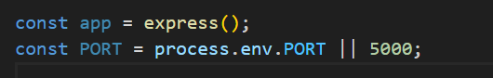
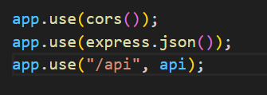
Node
Create a object for express & Set the PORT number
Includes cors ,json,routes

Slide 45
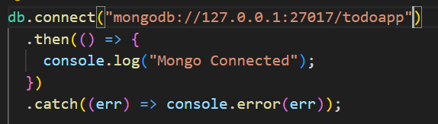
Node
Connect to the MongoDB

Slide 46
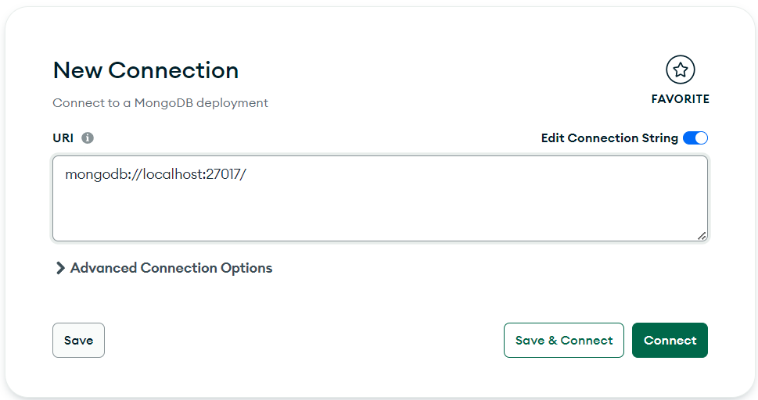
Node
Open MongoCompuss

Slide 47
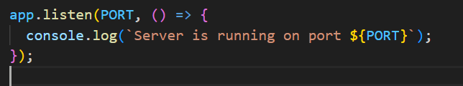
Node
Finally, Listen to the PORT:-

Slide 48
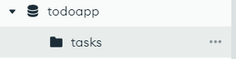
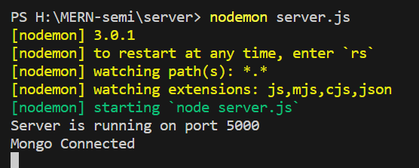
Node
Then start the server,

Slide 49
Congratulations!!!

Slide 50
Okie,What Next?

Slide 51
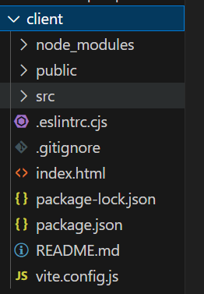
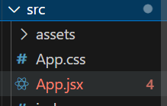
React
Design a frontend

Slide 52
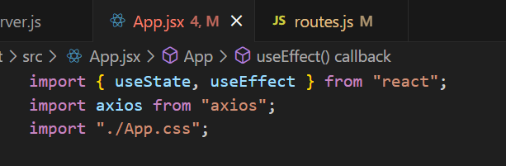
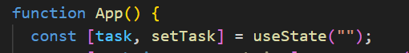
React
Import Necessary Packages
Create a variable :-

Slide 53
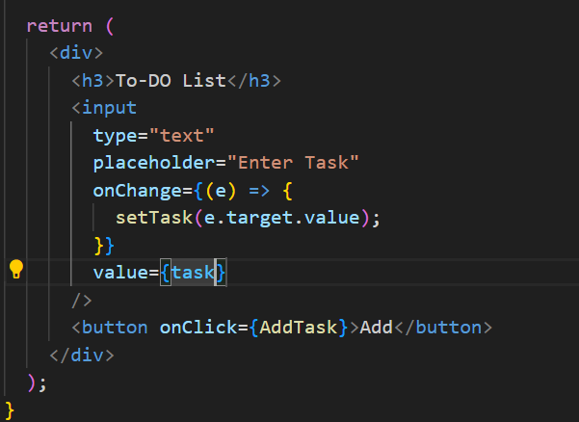
React
Create a element :-

Slide 54
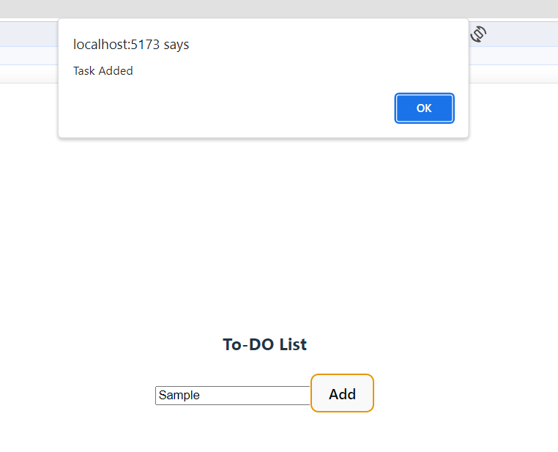
React
Create a element :-

Slide 55
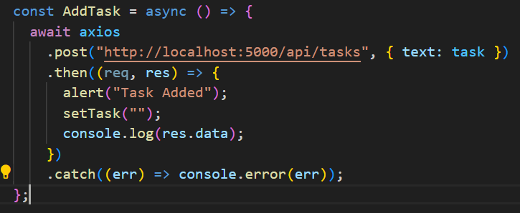
React
Create a fetch request for Create a element

Slide 56
React

Slide 57
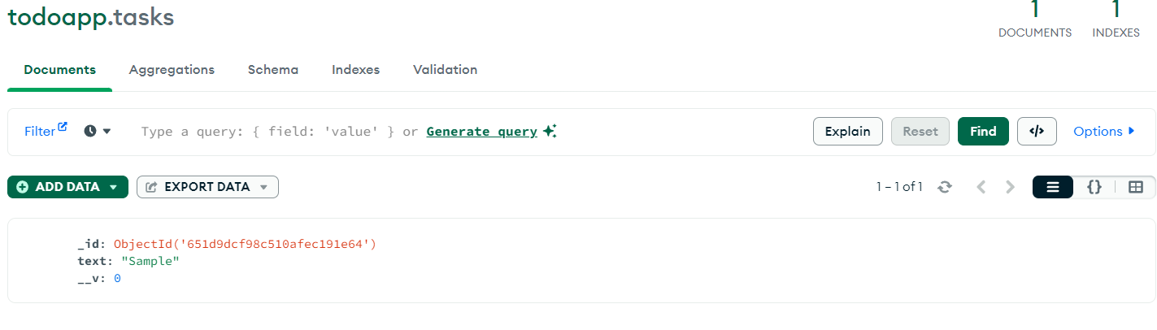
React

Slide 58
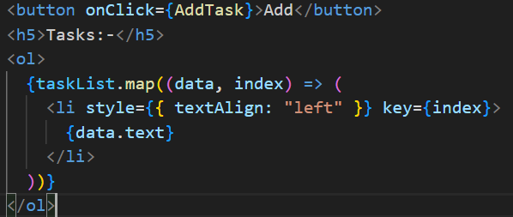
React
Read a element

Slide 59
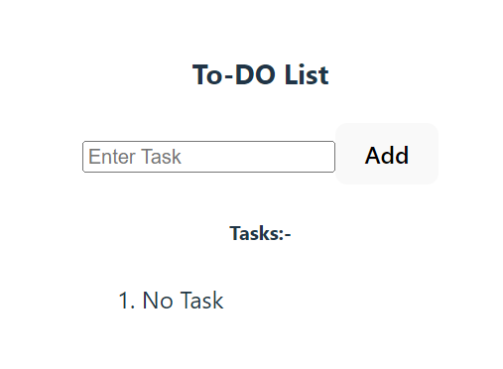
React
Read a element

Slide 60
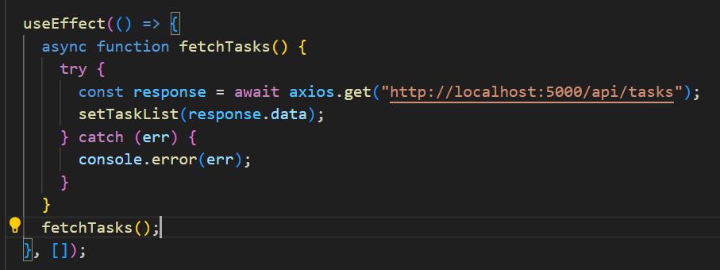
React
Create a fetch request for Read a element

Slide 61
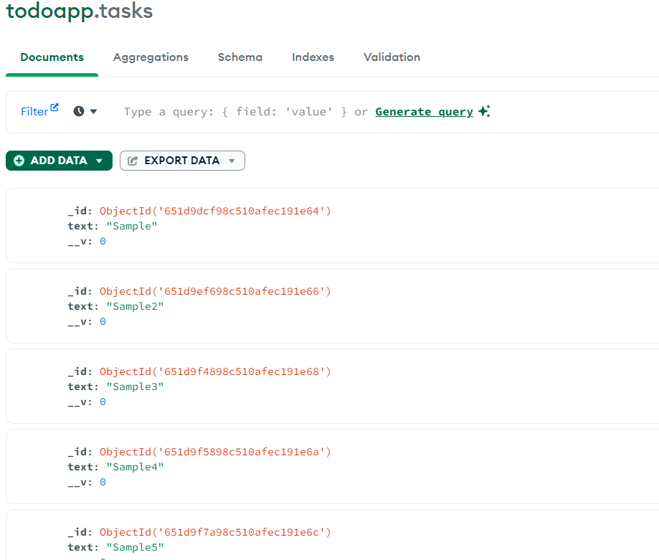
React
Create a fetch request for Read a element

Slide 62
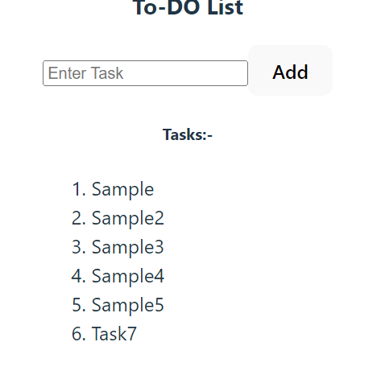
React
Create a fetch request for Read a element

Slide 63
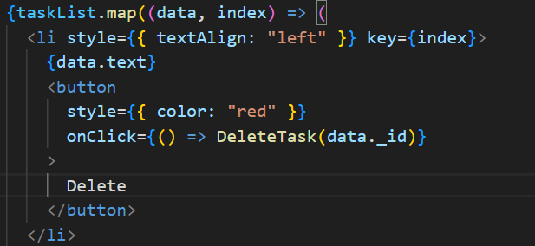
React
Add button for Delete a element

Slide 64
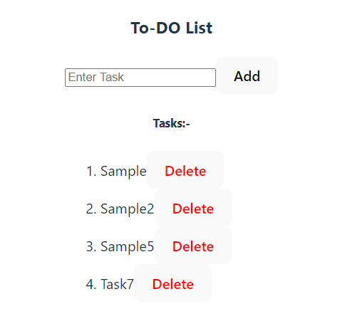
React
Add button for Delete a element

Slide 65
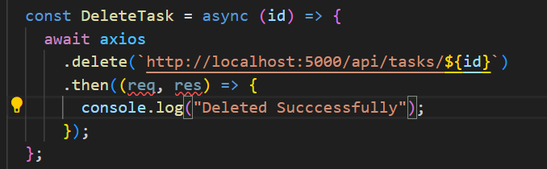
React
Create a method for delete

Slide 66

React
Create a button for update

Slide 67

React
Create a button for update

Slide 68

React
Create a method for update

Slide 69
React
Create a method for update

Slide 70

React
Create a method for update

Slide 71

React
Create a method for update

Slide 72


Slide 73
Congratulations!!!

Slide 74
OUR Final OUTPUT

Slide 75
Demo→→

Slide 76
Wait a Sec…Y?

Slide 77
Why>?

Slide 78
Which>?

Slide 79


Slide 80
Now,Our Final Output

Slide 81
Demo→→

Slide 82
Let’s Celeberate our Victory/..🤝<3

Slide 83
Any Queries???

Slide 84
Thank You

Slide 85
For reference use:
https://github.com/rc-balaji/MERN-semi.git

Slide 86

For reference use:
https://github.com/rc-balaji/MERN-semi.git

